Slide 1
react
Hook form

Slide 2

Hook form
React Hook Form is a library for building forms in React applications. Its primary objective is to simplify the process of form validation and data collection in React. It uses hooks as its core mechanism, making it easy to integrate with function components.

Slide 3
https://react-hook-form.com/dev-tools
npm install -D @hookform/devtools

Slide 4
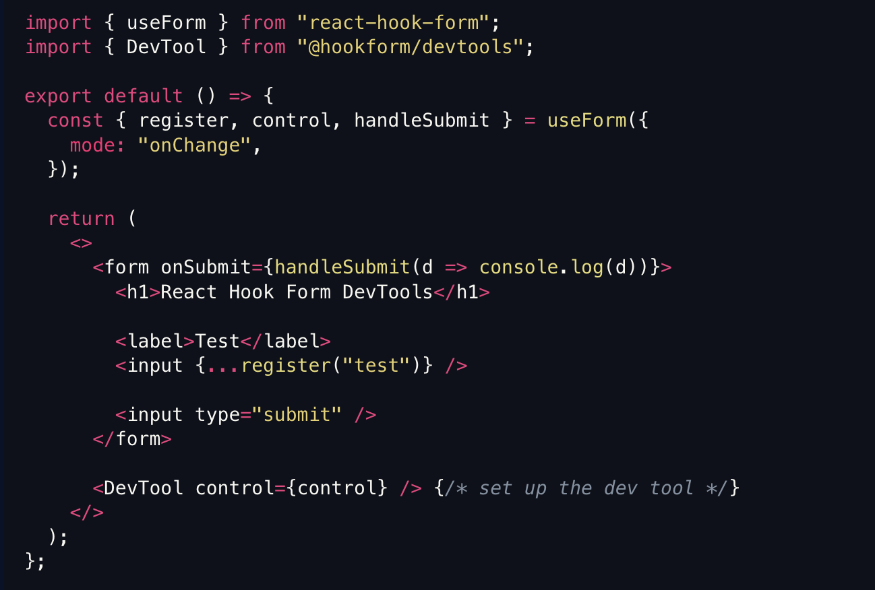
How do we add it

